Slide 1
Operating systems
Lecture #5

Slide 2
Content Lecture#4
01
Scheduling Algorithm
02
Scheduling Philosphy
03
Scheduling Criteria
04
Scheduling Queue
05
Scheuling

Slide 3
Lets take a Break
How does batman schedule a task on his computer?
With a .bat script

Slide 4
Revising Previous Lecture
Important System Calls Used in OS
fork()
Processes use this system call to create processes that are a copy of themselves. With the help of this system Call parent process creates a child process, and the execution of the parent process will be suspended till the child process executes.
exec()
This system call runs when an executable file in the context of an already running process that replaces the older executable file. However, the original process identifier remains as a new process is not built, but stack, data, head, data, etc. are replaced by the new process.
exit():
The exit() system call is used to terminate program execution. Specially in the multi-threaded environment, this call defines that the thread execution is complete. The OS reclaims resources that were used by the process after the use of exit() system call.
kill():
The kill() system call is used by OS to send a termination signal to a process that urges the process to exit. However, a kill system call does not necessarily mean killing the process and can have various meanings.
wait()
In some systems, a process needs to wait for another process to complete its execution. This type of situation occurs when a parent process creates a child process, and the execution of the parent process remains suspended until its child process executes.
The suspension of the parent process automatically occurs with a wait() system call. When the child process ends execution, the control moves back to the parent process.

Slide 5
I
Cooperating
F
A

Slide 6
Scheduling Algorithm Objectives
Max CPU utilization
Max throughput
Min turnaround time
Min waiting time
Min response time
Maximum CPU utilization obtained with multiprogramming
CPU–I/O Burst Cycle – Process execution consists of a cycle of CPU execution and I/O wait
CPU burst followed by I/O burst
CPU burst distribution is of main concern

Slide 7
Scheduling Philosophies
Preemptive
The system may preempt the CPU from a process at any time;
Prevents any one process from using the CPU for too long
Can lead to race condition (require synchronization techniques)
Non-preemptive
Each process voluntarily gives up the CPU
It is;
Simple
Easy to implement
Not suitable for multi-user systems
If the running process become blocked next process can be scheduled

Slide 8
Scheduling Criteria
CPU utilization
keep the CPU as busy as possible
Throughput
# of processes that complete their execution per time unit
Tunaround time
amount of time to execute a particular process
Waiting time
amount of time a process has been waiting in the ready queue
Response time
amount of time it takes from when a request was submitted until the first response is produced, not output (for time-sharing environment)
Priority
Priority assigned to that process or job
Class
Class of job, i.e. batch or on-line or real-time
Resource requirements
E.g. expected run time, memory required, etc
I/O or CPU bound
i.e. whether job is I/O bound or CPU bound
Resources used to date
i.e. the amount of processor time already consumed
Waiting time to date
i.e. the amount of time spent waiting for service so far

Slide 9
Process Scheduling Queues
Job queue
Set of all the processes in the system
It also includes the processes from the queues given below
Ready queue
Set of all the processes residing in main memory (ready or waiting)
Device queue
Set of processes waiting for an I/O devices

Slide 10
CPU Scheduler
Short-term scheduler selects from among the processes in ready queue, and allocates the CPU to one of them
Queue may be ordered in various ways
CPU scheduling decisions may take place when a process:
Switches from running to waiting state
Switches from running to ready state
Switches from waiting to ready
Terminates
Scheduling under 1 and 4 is non-preemptive
All other scheduling is preemptive
Consider access to shared data
Consider preemption while in kernel mode
Consider interrupts occurring during crucial OS activities

Slide 11
Levels of Scheduling
Scheduling can be exercised at three levels
High-level scheduling (Long-term scheduler)
Allow limited number of processes in the ready queue to compete
It disallows processes beyond a certain limit for batch processes first and in the end also the interactive processes
Invoke less frequently
May be slow
Medium-level scheduling (Medium-term scheduler)
It is concerned with decision to temporarily remove a process from the system (to reduce system load)
To reintroduce a process or swapping in
What if there is room in memory and both a new process as well as swapped out process want to be loaded
In this case, medium level scheduler has to work in close conjunction with high level scheduler

Slide 12
Levels of Scheduling
Low level-scheduling (Short-term scheduler)
Handles the decisions of which process is to be assigned to the processor (dispatcher)
Invoke very frequently
Must execute fast
Its scheduling could be preemptive or non-preemptive
Dispatch latency should be minimum
Dispatch latency is the time it takes for the dispatcher to stop one process and start another running
Example:
Assume a process runs for 90ms and scheduler run for 10ms
Overheads = 10/(90+10) = 10%
Any OS may use one or all of these levels, depending upon the desired
These levels have to interact amongst themselves closely to ensure the computing resources are managed optimally
The exact algorithms for these and interaction between them are quite complex

Slide 13
First Come First Serve Scheduling
The FCFS simply assign the processor to the process which is first in ready queue
When the processor is free, the next process at the head of the ready queue will be selected
Consider the following set of three processes that arrive at time ‘0’
Process ID Priority Burst Time
P1 2 30 ms
P2 3 6 ms
P3 1 4 ms
The waiting time for each process is P1=0, P2=30, P3=36
The average waiting time is (0+30+36)/3 = 22ms
The average waiting time of FCFS may vary substantially if the process’s CPU burst time vary greatly
P₁
P₂
P₃
0
30
36
40

Slide 14
First Come First Serve Scheduling
Salient points of FCFS
It is the simplest scheduling algorithm
Also know as the first in first out (FIFO)
FCFS is non-preemptive
It performs much better for long processes than short processes
It tend to favor CPU-bond processes over I/O bound
It is not suitable for time sharing system
FCFS is rarely used on its own but is effective if combined with other scheme

Slide 15
Shortest Job First Scheduling
This algorithm associates with shortest job first
When the CPU is available, it is assigned to the process that has smallest CPU burst time
If two processes have same CPU-burst then FCFS scheduling is used along with this to break the tie
Moving a short process before a long one
Decrease the waiting time of short process
Increase the waiting time of long process
Consequently, the average time decreases
This will result in a smaller number of PCB’s in the ready or blocked queues
The search time will be smaller, thus improving the response time
The number of satisfied user will increase
A long job in the queue may delayed indefinitely by a succession of smaller jobs arriving in ready queue
This can be avoided by setting higher external priority to those important jobs
The OS at any time can calculates a resultant priority based on both
Also known as shortest job next

Slide 16
Shortest Job First Scheduling
Salient Points of SJF
SJF may be preemptive or non-preemptive
It will preempt the currently executing process if its remaining time is greater than that of a newly arrived process
This scheme is known as shortest remaining time first
SJF is optimal in sense that it yields the smallest average waiting time
In general, it is difficult to predict the CPU time requirement for a process
SJF is optimal for batch jobs for which the run times are known in advance
SJF reduces average waiting time over FCFS

Slide 17
Shortest Job First Scheduling
Non-Preemptive SJF Scheduling
Process Arrival Time Burst Time
P₁ 0.0 7
P₂ 2.0 4
P₃ 4.0 1
P₄ 5.0 4
SJF (non-preemptive)
Average waiting time = (0 + 6 + 3 + 7)/4 = 4
P₁
P₃
P₂
P₄
0
3
7
8
12
16

Slide 18
Shortest Job First Scheduling
Preemptive SJF Scheduling
Process Arrival Time Burst Time
P₁ 0.0 7
P₂ 2.0 4
P₃ 4.0 1
P₄ 5.0 4
SJF (preemptive)
Average waiting time = (9 + 1 + 0 +2)/4 = 3
P₁
P₂
P₃
P₂
P₄
P₁
0
2
4
5
7
11
16

Slide 19
Round Robin Scheduling
The Round-Robin (RR) scheduling is designed especially for time sharing systems
In this algorithm there is small unit of time known as time quantum
A time quantum is generally up to 10-100ms
CPU scheduler goes around the ready queue, allocating the CPU to each process for a time interval of up to 1 quantum
For RR scheduling we keep the ready queue as a FIFO queue of processes
The CPU picks up the first process from the ready queue, set a timer to interrupt after 1 quantum
If the process burst time is less than 1 quantum
then the process itself release the CPU voluntarily & proceed to next process
If the process burst time is greater then 1 quantum
then that process is sent back to the ready queue and CPU scheduler selects the next process in the ready queue for scheduling

Slide 20
Round Robin Scheduling
Process Burst Time
P₁ 53
P₂ 17
P₃ 68
P₄ 24
Time quantum = 20 ms
The Gantt chart is:
Typically, higher average turnaround than SJF, but better response
P₁
P₂
P₃
P₄
P₁
P₃
P₄
P₁
P₃
P₃
0
20
37
57
77
97
117
121
134
154
162

Slide 21
Priority Scheduling
In priority scheduling a priority is associated with each process and the CPU is allocated to the process with the highest priority
Equal priority processes are scheduled in FCFS order
Priorities are generally some fixed range of numbers, such as 0, 1, 5, 10
There is no general agreement on whether ‘0’ is highest or lower priority
Priority can be defined on the bases of following
Process time limit
Memory requirements
Number of open files
Ratio of average I/O burst to CPU burst
Priority mechanism can be static or dynamic
Static priority mechanism is easy to implement and have relatively low overheads
Dynamic priority mechanism is more complex to implement and have greater overheads
The priority scheduling may be preemptive or non-preemptive
The choice arise when a high priority process comes in the queue while a low priority process is executing
A process that is ready to run but lacking the CPU can be considered blocked
Solution to indefinite blocking is aging
Aging is a technique of gradually increasing the priority of processes that waits for a long time
OS allows only a limited priority classes
In VAX / VMS priority range is 0 to 31
In Unix priority range is -20 to 20

Slide 22
Multilevel Queue
Ready queue is partitioned into separate queues: foreground (interactive) background (batch)
Each queue has its own scheduling algorithm,
foreground – RR
background – FCFS
Scheduling must be done between the queues
Fixed priority scheduling; (i.e., serve all from foreground then from background)
Possibility of starvation
Time slice – each queue gets a certain amount of CPU time which it can schedule amongst its processes; i.e., 80% to foreground in RR
20% to background in FCFS

Slide 23
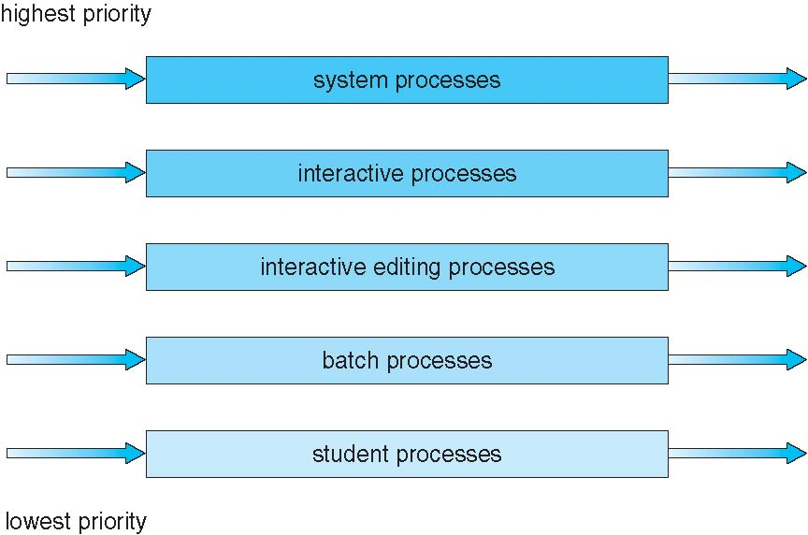
Multilevel Queue Scheduling

Slide 24
Multilevel Feedback Queue
A process can move between the various queues
aging can be implemented this way
Multilevel-feedback-queue scheduler defined by the following parameters:
number of queues
scheduling algorithms for each queue
method used to determine when to upgrade a process
method used to determine when to demote a process
method used to determine which queue a process will enter when that process needs service
Example
Three queues:
Q₀ – time quantum 8 milliseconds
Q₁ – time quantum 16 milliseconds
Q₂ – FCFS
Scheduling
A new job enters queue Q₀ which is served FCFS
When it gains CPU, job receives 8 milliseconds
If it does not finish in 8 milliseconds, job is moved to queue Q₁
At Q₁ job is again served FCFS and receives 16 additional milliseconds
If it still does not complete, it is preempted and moved to queue Q₂

Slide 25
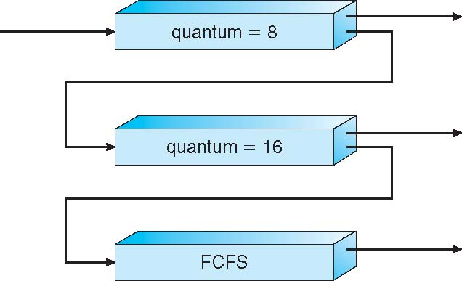
Multilevel Feedback Queues

Slide 26
Lab
Run exec and file descriptor

Slide 27
Thank you

